Slide 1
أكـــــاديميــــة طــــويـــق
Artificial Intelligence Ethics

Slide 2
AI Regulations and Legal Frameworks
By: Dr. Afshan Hashmi

Slide 3
Course Objectives:
Understand the global landscape of AI regulations
Explain the role of GDPR in regulating AI
Identify legal and ethical challenges
Analyze industry-specific regulatory requirements
Evaluate the impact of AI laws on innovation, accountability, and human rights.
Develop strategies for aligning AI systems with current legal frameworks

Slide 4

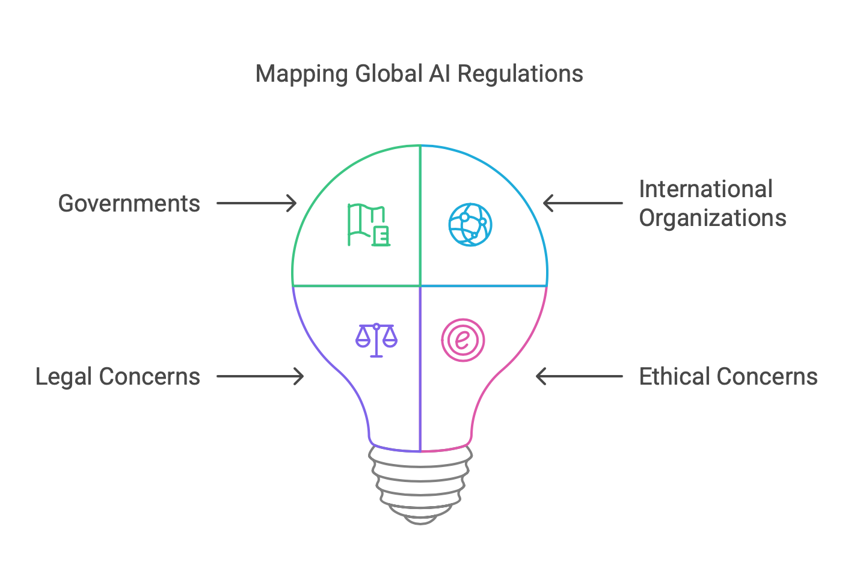
Overview of Global AI Regulations
Artificial Intelligence (AI) has become a transformative force across industries, raising critical legal and ethical concerns. Governments and international organizations are actively working to establish regulatory frameworks to ensure responsible and safe development and deployment of AI technologies.

Slide 5
a. EU AI Act
The EU AI Act is a landmark legislative proposal by the European Union that aims to regulate Artificial Intelligence across its member states. Introduced in April 2021, it is the first major legal framework globally that sets rules for how AI systems should be designed, developed, and used to ensure safety, transparency, and respect for fundamental rights.
Key Elements :
Risk-based approach: AI systems are categorized by the potential risk they pose:
Unacceptable risk (e.g., social scoring by governments) – banned.
High-risk (e.g., AI in medical devices, hiring tools) – subject to strict obligations.
Limited risk – must meet transparency requirements.
Minimal risk – free to operate with no specific regulation.
High-risk systems require:
Detailed documentation
Clear transparency procedures
Human oversight to prevent harmful outcomes.
Prohibited AI practices: Includes systems that manipulate human behavior or exploit vulnerabilities (e.g., scoring systems that evaluate trustworthiness of individuals).

Slide 6
a. EU AI Act overview
Status: First comprehensive legal framework on AI proposed by the European Commission in April 2021.
Purpose: To ensure AI systems used in the EU are safe, respect fundamental rights, and are trustworthy.
Key Features:
Risk-based approach: AI systems categorized as unacceptable risk, high risk, limited risk, and minimal risk.
High-risk systems (e.g., biometric ID, critical infrastructure) require strict compliance and transparency.
Obligations for providers and users: documentation, transparency, human oversight.
Prohibits certain AI uses (e.g., social scoring by governments).
Why It Matters:
This Act sets a global precedent for AI regulation. It seeks to balance innovation and safety by ensuring AI is used responsibly, without hindering technological progress. The Act affects developers, providers, and users of AI both within and outside the EU, if their systems impact EU citizens.

Slide 7
b. US Executive Orders and Initiatives
The United States takes a sector-specific approach to AI regulation rather than having a single unified AI law like the EU. Instead of one all-encompassing framework, the U.S. uses executive orders, agency-level guidelines, and voluntary frameworks to guide responsible AI development.
Executive Order on Safe, Secure, and Trustworthy AI (2023)
This is a significant policy move by the U.S. government to address the rapid growth and risks of AI. Key highlights include:
Aligning AI with national goals such as economic growth, national security, and civil rights protection.
Establishing protocols for testing, red-teaming, and risk evaluation before deploying AI models—especially those used by the government.
Mandating federal agencies to assess and mitigate harms like bias, misuse, and discrimination in AI systems.
Supporting Initiatives:
NIST AI Risk Management Framework: Offers tools for companies to manage and reduce AI-related risks (accuracy, robustness, fairness).
OSTP Blueprint for an AI Bill of Rights: Suggests principles like data privacy, transparency, and freedom from algorithmic bias.

Slide 8
b. US Executive Orders and Initiatives- overview
The United States does not have a unified AI regulation but follows a sectoral approach.
Executive Order on Safe, Secure, and Trustworthy AI (2023):
Ensures AI development aligns with national security, economic competitiveness, and civil rights.
Establishes guidelines for AI testing, risk assessments, and federal use of AI.
Promotes innovation while protecting privacy, civil liberties, and public safety.
Other frameworks: NIST AI Risk Management Framework, OSTP Blueprint for an AI Bill of Rights.
Supporting Initiatives:
NIST AI Risk Management Framework: Offers tools for companies to manage and reduce AI-related risks (accuracy, robustness, fairness).
OSTP Blueprint for an AI Bill of Rights: Suggests principles like data privacy, transparency, and freedom from algorithmic bias.

Slide 9
c. Other Countries – AI Regulations Overview
This section highlights how countries outside the EU and US are approaching AI governance. While they may not yet have comprehensive AI laws like the EU AI Act, they are actively shaping their regulatory landscapes.

Slide 10
CHINA AI Regulations
Focus: Emphasis on algorithmic transparency and content control.
China has introduced specific rules for recommendation algorithms and generative AI models.
Platforms must ensure their algorithms do not promote harmful content or misinformation.
Providers are also required to register algorithms and provide user control features.

Slide 11
Canada AI Regulations
Canada has proposed the Artificial Intelligence and Data Act (AIDA), under Bill C-27.
AIDA aims to regulate high-impact AI systems and promote responsible AI development.
It emphasizes transparency, fairness, and accountability, with enforcement powers granted to a new AI and Data Commissioner.

Slide 12
OECD (Organisation for Economic Co-operation and Development) AI Regulations
Not a country, but an international organization with over 30 member nations.
It developed the OECD Principles on AI, a widely adopted framework promoting:
Transparency
Accountability
Fairness
Human-centered values
These principles serve as non-binding global standards influencing national policies.

Slide 13
Comparison Table: Global Approaches to AI Regulation
Country/Region | Regulation/Initiative | Type of Approach | Key Features
EU | EU AI Act | Comprehensive legislation | Risk-based classification, bans harmful AI, enforces transparency
USA | Executive Orders, NIST Framework, AI Bill of Rights | Sectoral + voluntary | Emphasis on innovation, fairness, federal agency oversight
China | Generative AI & Algorithm Regulations | Strict, state-guided | Algorithm registry, content control, transparency
Canada | Artificial Intelligence and Data Act (AIDA) | Draft legislation | High-impact system regulation, proposed AI Commissioner
OECD | AI Principles | Voluntary, international | Guidelines for transparency, accountability, human-centric AI

Slide 14
GDPR and AI: Privacy and Data Protection Regulations
The General Data Protection Regulation (GDPR), enforced in the European Union since May 2018, has significant implications for AI systems, especially those that rely on personal data.
GDPR’s Relevance to AI
Since many AI systems use personal data (like user profiles, medical records, or facial images), GDPR plays a crucial role in shaping how AI is designed and deployed in the EU.
Key Provisions Impacting AI Systems:
Lawful Basis for Processing AI systems must have a legal reason to process data—like user consent or legitimate interest. You can’t just scrape personal data and use it for training without legal grounds.
Data Minimization and Purpose Limitation Only the minimum data needed should be collected, and only used for clearly stated purposes—no vague or unexpected secondary uses.

Slide 15
GDPR and AI: Privacy and Data Protection Regulations
Right to Object and Opt-Out (Article 22) People can opt out of being subjected to decisions made only by AI—especially decisions that significantly affect them (e.g., rejections for jobs or insurance).
Data Protection Impact Assessments (DPIAs) If the AI system is high-risk (e.g., surveillance or profiling), a DPIA is required to assess and mitigate privacy risks before deployment.
Anonymization and Pseudonymization These are recommended practices to protect identity while still allowing AI to learn from the data.
Importance of Compliance
Violating GDPR can lead to hefty fines (up to €20 million or 4% of global turnover). So AI developers must build privacy into AI systems from the start—a concept known as Privacy by Design.

Slide 16
Industry-Specific AI Regulations?
While general AI laws like the EU AI Act or GDPR apply across sectors, industry-specific AI regulations address the unique risks, use cases, and ethical concerns of particular domains. Each sector has specialized rules to ensure that AI systems are safe, ethical, and legally compliant within that context.

Slide 17
a. Healthcare
AI is used for diagnostics, personalized medicine, and treatment recommendations. Since health data is extremely sensitive:
Medical Devices: AI-based diagnostic tools often require regulatory approval:
US: Must be approved by the FDA.
EU: Must have CE marking under the Medical Device Regulation.
HIPAA (US): Controls how AI systems handle protected health information (PHI).
Ethical Issues:
Bias in AI models could lead to misdiagnosis.
Patients should give informed consent if AI is used in their treatment.
Explainability is crucial—doctors and patients need to understand AI recommendations.

Slide 18
b. Finance
AI is used in fraud detection, algorithmic trading, and credit scoring. It must meet strict governance and transparency standards:
Basel Committee (BCBS): Provides guidance on AI risk management in banking.
DORA (EU): Ensures AI systems are resilient and well-tested.
US regulators: Require model validation and auditability of AI in financial services.
Fair Lending Laws:
Prevent bias or discrimination in automated decisions (e.g., AI denying loans based on race or ZIP code).
Explainability is vital to justify decisions.

Slide 19
c. Autonomous Vehicles (AVs)
AI powers self-driving cars, which raises issues about public safety, accountability, and ethics:
UNECE WP.29 (a UN working group): Sets international rules for cybersecurity and software updates in AVs.
National Guidelines:
US (California DMV): Provides rules for AV testing and reporting of crashes.
UK’s AV Bill: Defines liability, insurance, and conditions for autonomous driving.
Key Concerns:
Who is responsible in a crash? The driver, manufacturer, or software developer?
AI must make ethical decisions in complex situations (e.g., crash scenarios).

Slide 20
AI Regulation Summary
Helps developers ensure AI applications comply with laws and ethical standards.
Enables businesses to avoid legal risks and penalties through proper compliance.
Supports policymakers in creating robust frameworks that balance innovation and safety.
Promotes transparency and trust among users and the public.
Ensures responsible and fair use of AI technologies across sectors.
Encourages continuous monitoring and adaptation to evolving AI regulations worldwide.

Slide 21
Resources for Further Study
EU AI Act – Full Text: https://artificialintelligenceact.eu
Executive Order on Safe, Secure, and Trustworthy AI (2023): https://www.whitehouse.gov
NIST AI Risk Management Framework: https://www.nist.gov/itl/ai-risk-management-framework
GDPR Text and Resources: https://gdpr.eu
OECD AI Principles: https://oecd.ai
Healthcare AI Regulations (FDA Guidelines): https://www.fda.gov
UNECE Autonomous Vehicle Regulations: https://unece.org

Slide 22


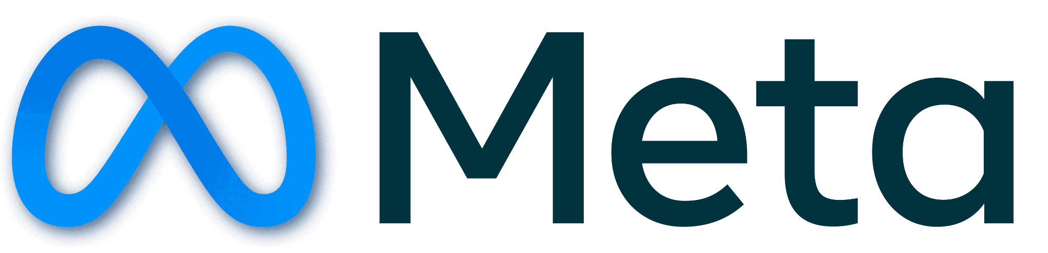






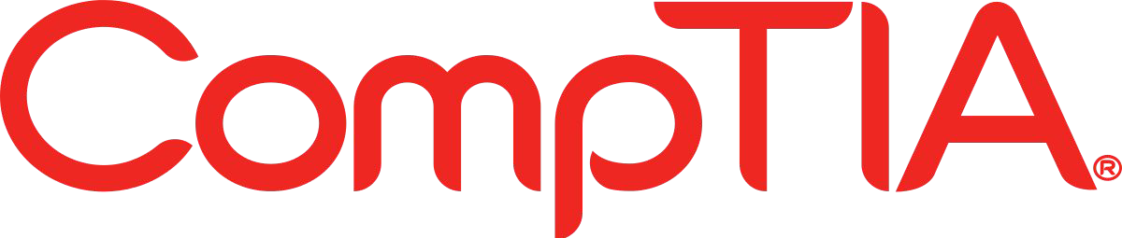

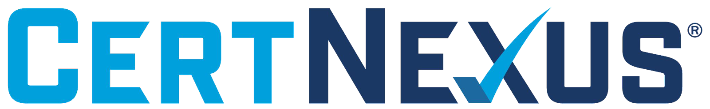





الشراكات العالمية

Slide 23
شــــــكــــرًا لكــــــم
THANK YOU

